Slide 1
INSULINS

Slide 2
Classification of Diabetes
Type 1 Diabetes
Type 11 Diabetes
Diabetes due to secondary causes
Gestational Diabetes

Slide 3
Insulin
Polypeptide with 2 peptide chains
Linked by 2 disulphide Bonds
Metabolic activity is common to all mammalian species
Daily secretion 30-40 units

Slide 4
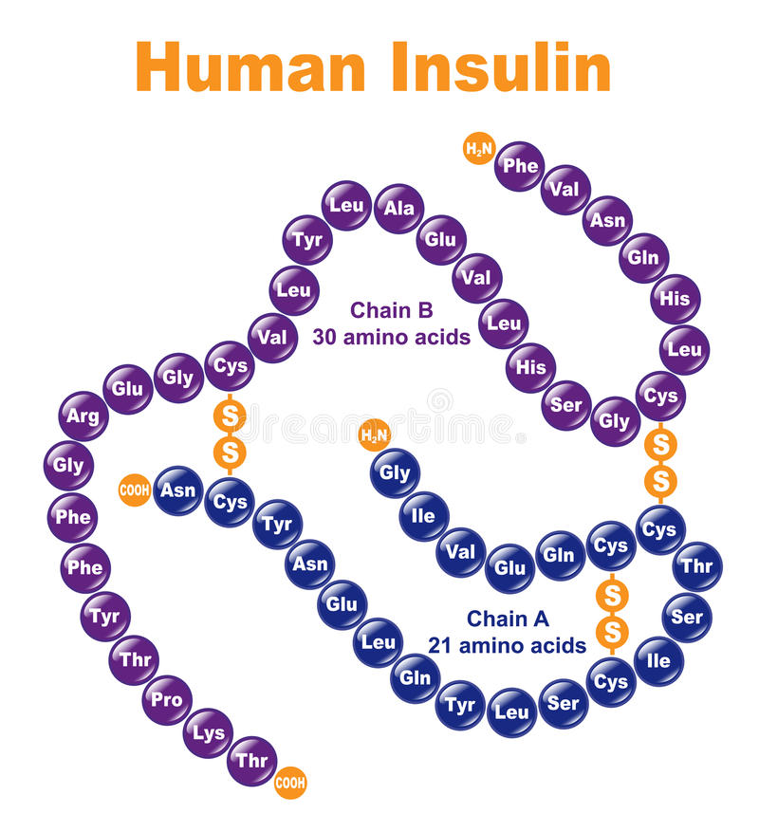

Slide 5
Pharmacokinetics
Injected because digested if swallowed
Absorbed in to the blood inactivated in the liver and kidney.
10% appear in urine.
T 1/2 is 5 min
Peak plasma concentration is in 30-90 min

Slide 6
Sources of Insulin
Bovine Insulin- Differs by 3 amino acids
Porcine Insulin- By 1 amino acid
Human Insulin
  Enzyme Modification of porcine Insulin
  Recombinant DNA technology

Slide 7
Insulin analogues
Modified insulins to alter its absorption characteristics
  Insulin lispro
  Insulin aspart
  Insulin glargine
  Insulin detemir

Slide 8
Preparations of Insulins.
Source of Insulin(Human,Bovine,Porcine)
Formulation
  Short acting
  Intermediate acting
  Long acting

Slide 9
Short Duration of action Insulins
Rapid onset of action
  Soluble Insulin
  Insulin Lispro
  Insulin aspart

Slide 10
Intemediate duration of action & long acting insulins
NPH insulin (Neutral Protamine Hagedorn) insulin-Isophane Insulin - A suspension with protamine
Insulin glargine (Lantus insulin)
Insulin detemir (Levamir insulin)

Slide 11
Insulin mixtures
Mixture of soluble insulin and Isophane insulin
Most commonly used ones are human Insulins
Soluble Insulin at 10-50% of total Insulin concentration
Remove the need for patients to mix Insulin

Slide 12
Indications for use of Insulin.
Type 1 Diabetes mellitus
Type 11 Diabetes
  Diabetic ketoacidosis
  Non ketotic hyper osmolar coma
  Surgery
  Infections
Pregnancy

Slide 13
Side effects of Insulin
Hypoglycaemia
  Warning signs due to Neuroglycopenia
  Coma ,Convulsions and Death
Allergic reactions
Lipoatrophy
Lipohypertrophy

Slide 14
Soluble Insulin
Short duration of action
Used 30m before meals
3 times a day
Colourless.
Is given I.V in diabetic ketoacidosis.

Slide 15
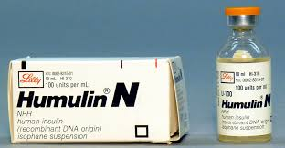

Slide 16
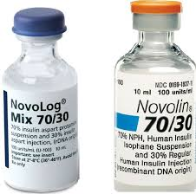

Slide 17
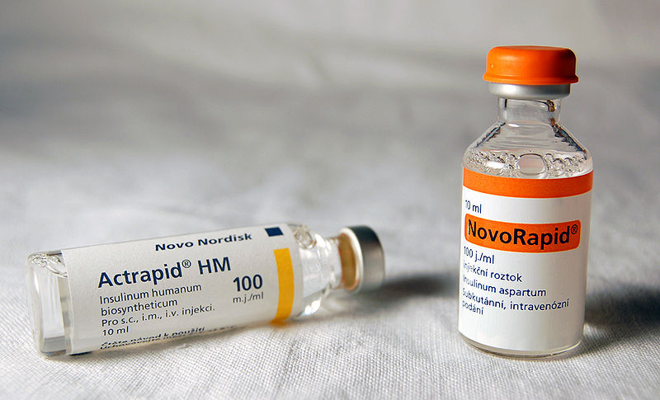

Slide 18
Dose of Insulins
100u/ml
Total daily output is 30-40 units a day
Daily increment is 4 units a day.
A dose of over 100u/day is due to noncompliance.

Slide 19
Insulin devices
Pens
Pumps

Slide 20
Advice to the patient
Don’t skip a meal
Signs of hypoglycaemia
Card
Sweet

Slide 21
Insulin + OHG
When to use
Advantages

Slide 22
Glucagon
Main clinical use is IM in patients who are unconcious at home who cannot have Iv access or oral glucose

Slide 23
Mointoring
FBs
PPBs
Hb A1c
Blood sugar series

Slide 24
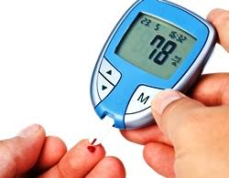

Slide 25
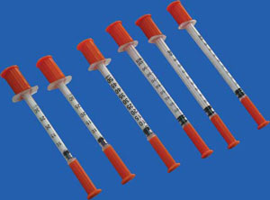

Slide 26
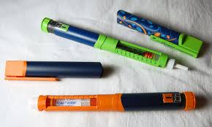

Slide 27


Slide 28
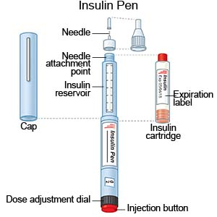

Slide 29
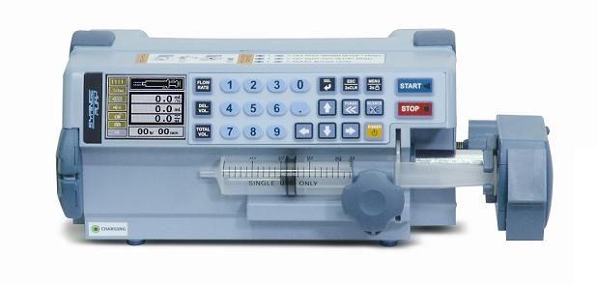

Slide 30
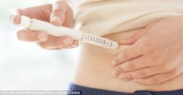

Slide 31
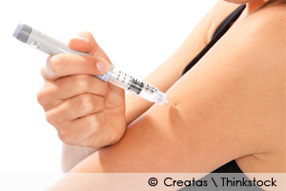

Slide 32
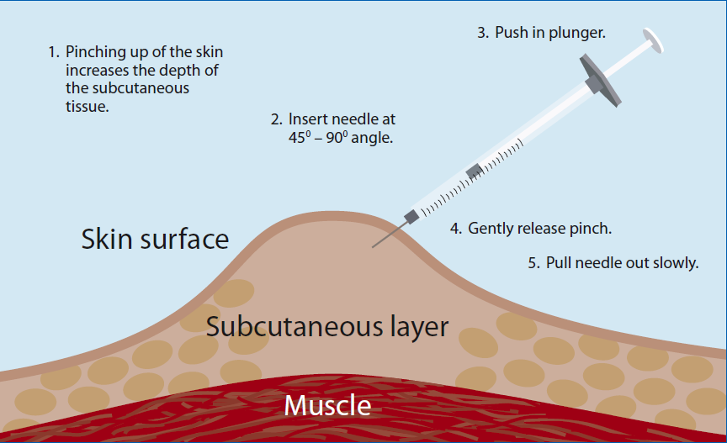

Slide 33
Management of complications
Hypercholesterolaemia/Hyperlipdaemia
  Statins/Fibrates
Hypertension
  ACEI/ARB/Calcium channel blockers
Microalbumin uria/ Nephropathy
  ACEI/ARB

Slide 34
Diabetic emergencies
DKA
Non ketotic hyperosmolar coma
Hypogycaemic coma

Slide 35
DKA

Slide 36
Non ketotic hypeosmolarcoma

Slide 37
Hypoglycaemic coma
Sweets
IV dextrose
Im glucagon

Slide 38
Diabetes in pregnancy

Slide 39
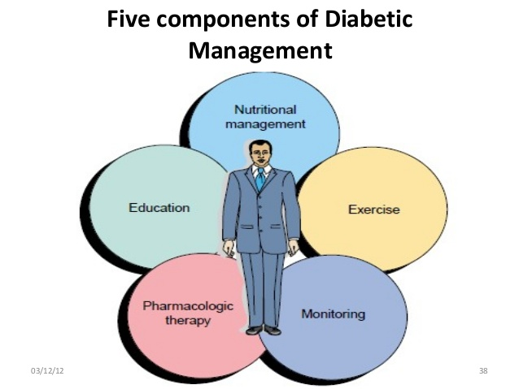

Slide 40
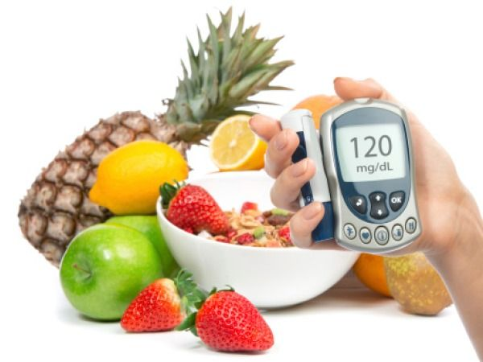

Slide 41
